Slide 1


PRINCIPLES OF ARTIFICIAL INTELLIGENCE
SOF106
DR SHAMINI RAJA KUMARAN
GENETIC ALGORITHM
www.website.com
PREPARED BY DR SHAMINI

Slide 2
XMUM VISION
Xiamen University Malaysia aspires to become a university with a distinct global outlook, featuring first-class teaching and research, and embracing cultural diversity.
XMUM MISSION
To nurture young talents with dignity and wisdom, turning them into fine citizens of the region who will contribute to the prosperity of the people and social progress of Malaysia, China and Southeast Asia.To nurture young talents with dignity and wisdom, turning them into fine citizens of the region who will contribute to the prosperity of the people and social progress of Malaysia, China and Southeast Asia.

Slide 3
GENETIC ALGORITHM CONCEPT
INITIAL POPULATION
FITNESS FUNCTION
ENCODING : Binary Encoding, Value Encoding, Permutation Encoding
RECOMBINATION : Roulette wheel selection, Tournament Selection, Rank selection, Steady state selection
REPRODUCTION: Crossover, Mutation
TERMINATION CRITERIA

Slide 4
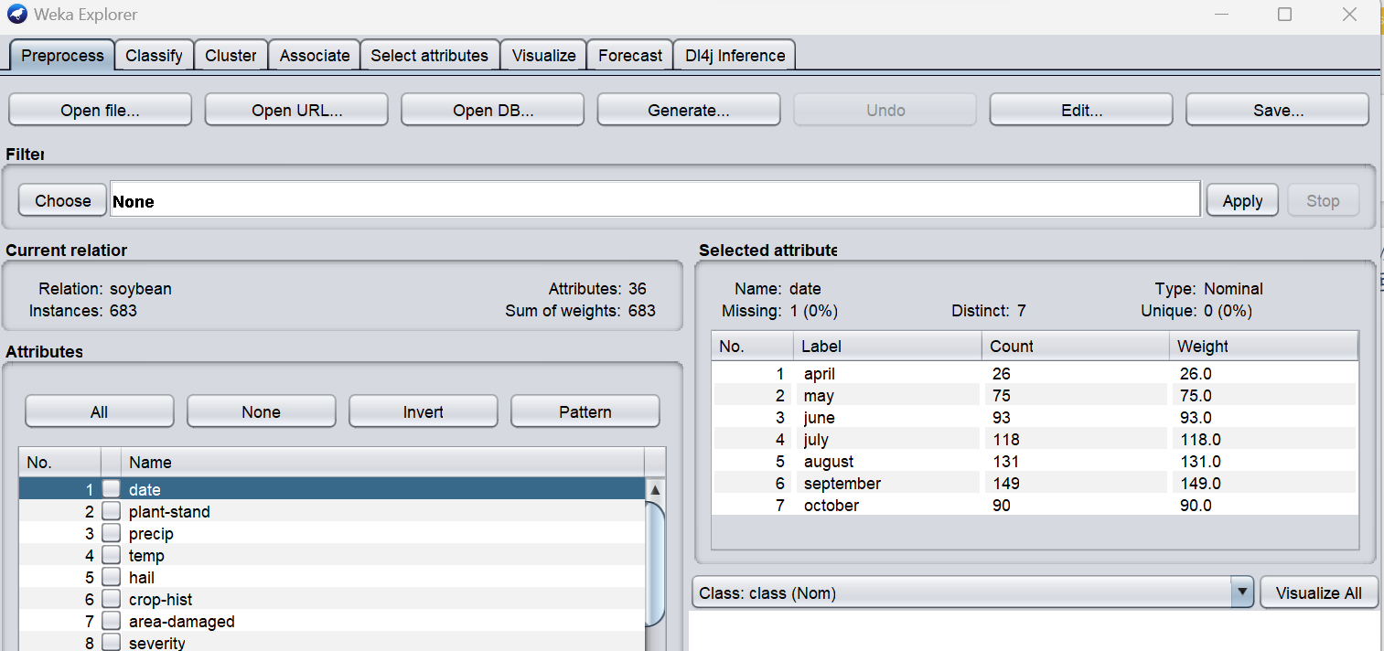
GENETIC ALGORITHM
Open the Weka GUI Chooser.
Click the “Explorer” button to launch the Explorer.
Open the soybean.arff dataset.
Click the “classify” tab to access the CLASSIFICATION.

Slide 5
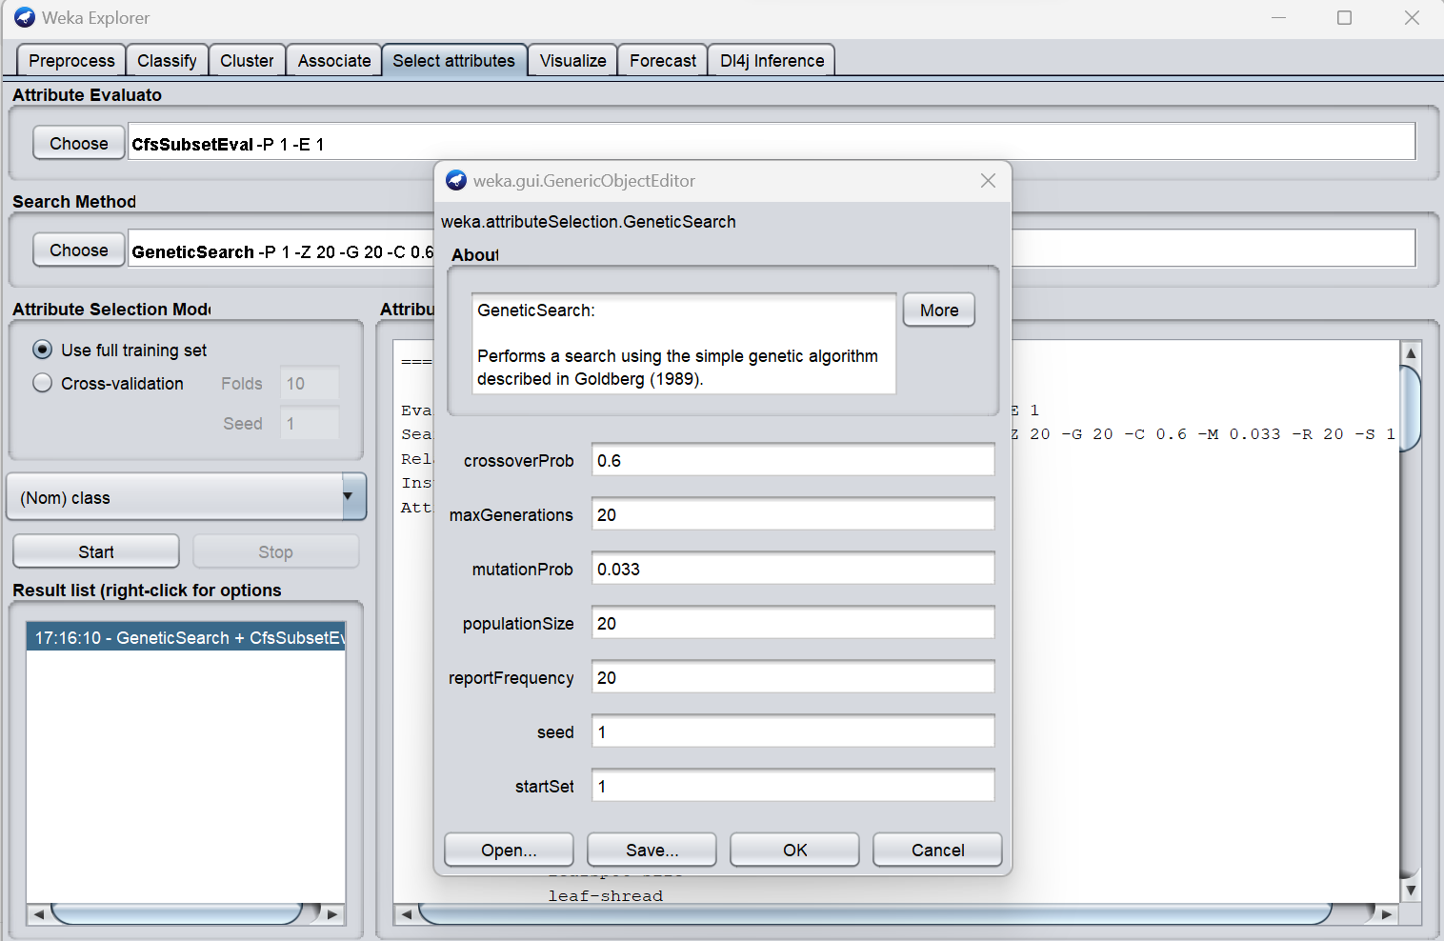
GA-FEATURE SELECTION
Population Size (-P): This parameter sets the population size for the genetic algorithm. A larger population size allows for more exploration of the feature space but may slow down the algorithm.
Generations (-G): The number of generations controls how many iterations the genetic algorithm will run. More generations can lead to better results, but it also increases computation time.
Crossover Probability (-C): This parameter determines the likelihood that two feature subsets will be combined (crossover) in each generation. Higher values encourage more exploration of the feature space, while lower values preserve the current features.
Mutation Probability (-M): Mutation is the process where random changes are made to a feature subset. This parameter controls the likelihood of mutation. A higher mutation rate encourages exploration of different subsets.
Start Set (-S): You can provide a start set of features that are considered as a starting point for the genetic search. This can be useful if you have prior knowledge about which features are likely to be important.

Slide 6
THANK YOU
www.website.com
PREPARED BY DR SHAMINI

